Slide 1
Welcome to all
for the MHRM Online lecture
By
Dr. Dhiraj Ovhal
HOD of Commerce

Slide 2
Chapter -3
Marketing Decision –II
(Place and Promotion)
Promotion

Slide 3
Meaning and Definition of Marketing Mix?
Meaning:- Marketing mix means of Combination of
“4 Ps” i.e. Product, Price, Place & Promotion
Definition:- In 1960, E. Jerome McCarthy defines
“The basis of Marketing operations is the co-ordination of four key variables, namely : Product, Price, Place and Promotion”.
( Way to remember :- -co-ordination of four key variables, )

Slide 4
Q.6 Elements of promotion Mix
Meaning :-
Communication
To make aware the customers
Publicity or propaganda

Slide 5
Q.6 Elements of promotion Mix
Advertising
Salesmanship
Sales promotion
Publicity
Sponsorship
Public relationship
Packaging
Direct Marketing
Trade fair and Exhibition

Slide 6
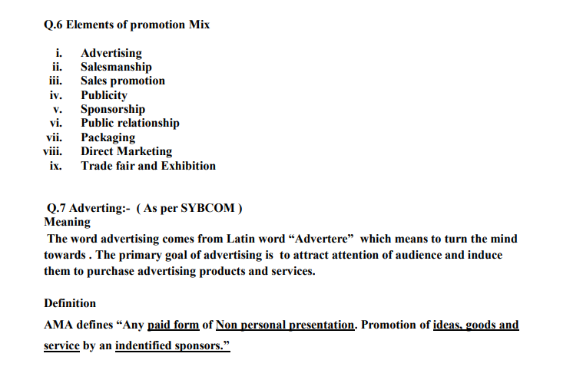

Slide 7
Q.1 Write Meaning, Definition and Features of Advertising
Meaning:- The word advertising comes from Latin word “Advertere” which means to turn the mind towards .
The primary goal of advertising is to attract attention of audience and induce them to purchase advertising products and services.
Definition:- Definition AMA defines (American Marketing
Association)
“Any paid form of Non personal presentation,
Promotion of ideas, goods and service by an
indentified sponsor.”

Slide 8
Features/Characteristics/ Natures/ Objectives/Essential
(Shortcut to remember )
Definition has 4 features point +
CAT ABCDEF
1) Paid form
2) Non personal presentation Definition has 4 features point
3) Ideas, goods and service
4) Indentified Sponsors
5) Creativity
6) All pervasive
7) Target Market
8) Arts, Science & Profession
9) Build Image CAT, ABCDEF
10) Create awareness
11) Diverse groups
12) Elements of marketing mix
13) Facilities to the customers

Slide 9
1.Paid Form
It is paid form concept.
Advertiser/Seller/Manufacture/Real
Owner
Adverting Campaign
Media
Publicity is not paid form.

Slide 10
2. Non personal presentation
It is non personal presentation of commercial message
The basic objectives to convey advertising messages to the audience and induce them to purchase
advertising products/services
Salesmanship is personal form

Slide 11
3.Ideas, Goods and Services
Goods :- Tangible things such as Mobile, Car, Soap, etc.
Services :- Intangible Services such as Banking, Telecommunication, Insurance, etc.
Ideas:- Pulse polio campaign, Blood donation, Save Girl child, Stay Safe & Stay Home ---- Corona Awareness

Slide 12
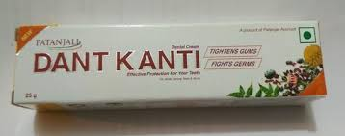
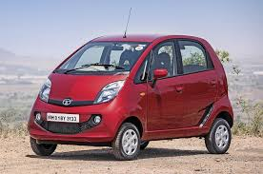
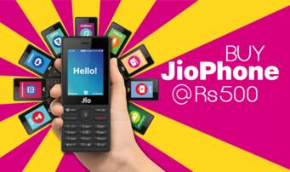
Indentified sponsors:-
For Example :- The Owner/ Seller/ Manufacture/
Retailer/ Govt.Orgn./ Hopsitals/
Jio Phone . Nano Car, Dant Karanti

Slide 13
5. Creativity :-
New concept of ads
Innovative / Unique things
for example:- ZOO ZOO ads, Menthos

Slide 14
6. All pervasive:-
Universal application
Applicable to business as well as
Non-business organisation
For examples:- SYBCOM admission
form and Notice ..
Attended Zoom meeting

Slide 15
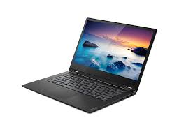
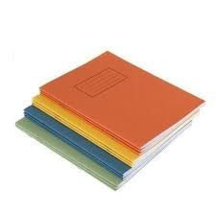
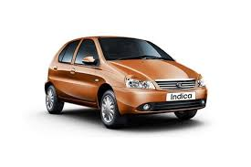
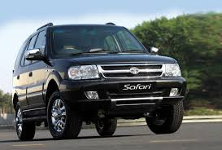
7. Target Market:- One can not sell everything to everyone.

Slide 16
8. Arts, Science & Profession
Arts:- It is required skills & Talent to prepare ad campaign
Science :- It is part of social science which is basically deals with human being ( Customers)
Profession:- Now days due to tough competition in the market, for market share it is seeking helps from profession ad agencies

Slide 17
9. Build Image:-
Increase Name and reputation of Brand.
Use Brand personalities to promote products like
Pappu Paas Ho Gaya– Cadbury dairy milk..
Harpic– Akashay Kumar

Slide 18
10. Create Awareness :-
Not only provide details but also
Mention whether Environmentally friendly or not.
All contents /ingredients information.
Use of products .
Price & Features of the products,etc.

Slide 19
11. Diverse groups
Primary applicable to Customers
Other stakeholders
Wholesaler, Retailers, Supplier, etc,
Try to covert Audience into prospects
and prospects into customers

Slide 20
12. Elements of marketing mix
Marketing Mix means “4 P”S
Product
Price
Place
Promotion

Slide 21
13. Facilities to the customers
To help
Provide all details like price ,
features, quality, etc,
Easy for customers to select right product as per requirement / budget
For example:-
iphone :- Luxury mobile/ Best quality
Selfy camera :- Oppo Phone

Slide 22
Features/Characteristics/ Natures/ Objectives/Essential
(Shortcut to remember )
Definition has 4 features point +
CAT ABCDEF
1) Paid form
2) Non personal presentation Definition has 4 features point
3) Ideas, goods and service
4) Indentified Sponsors
5) Creativity
6) All pervasive
7) Target Market
8) Arts, Science & Profession
9) Build Image CAT, ABCDEF
10) Create awareness
11) Diverse groups
12) Elements of marketing mix
13) Facilities to the customers

Slide 23
Thank You

Slide 24
Attendance Link
https://forms.gle/Xqvykv5vfEi1zpyF7
(Mention date at last point)

